Slide 1
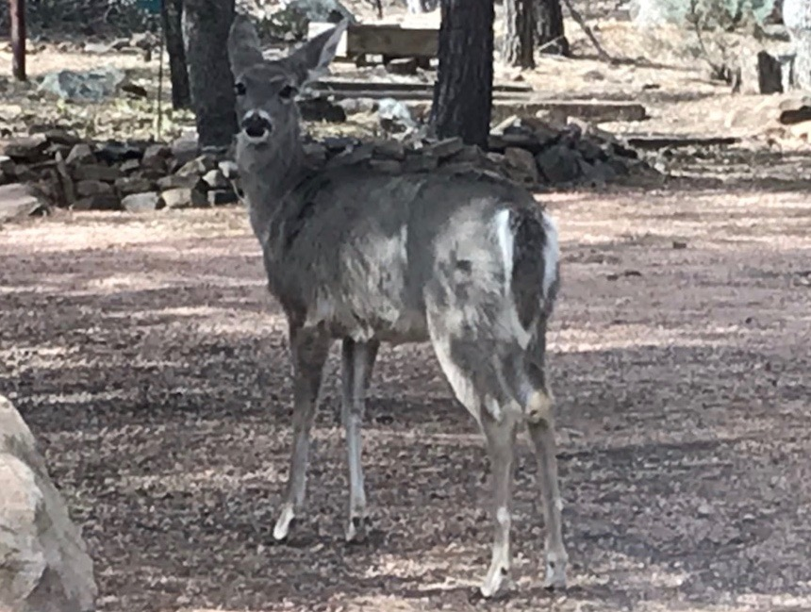
Portals III HOA
Sign Committee
March 23, 2019

Slide 2
Recap Last HOA Meeting
Board approved $300 for new security sign
Board was not in favor of yellow Private Rd sign, nor any private road sign without more information
Board agreed with the committee to have minimal signage and use earth colors on signs

Slide 3
Since Then
Nearly 40 old signs removed - and will not be replaced!
Thank you to Tom Leeuw & Chuck Casey for all the work - only expense $20. dump fee

Slide 5
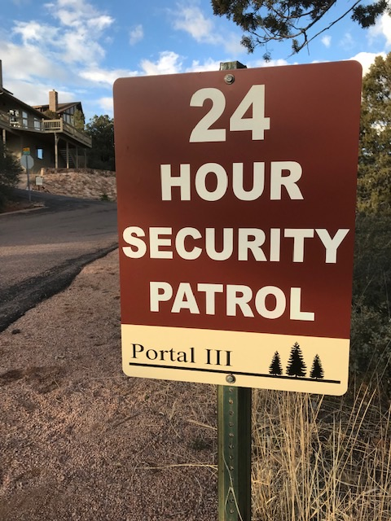
INFORMATIONAL SIGNAGE 1st Sign
First Sign was put up and Feedback was solicited
Feedback was received via email and on Website 27 people
Most was positive and all was encouraging of the committees work
Cost — $44.

Slide 6
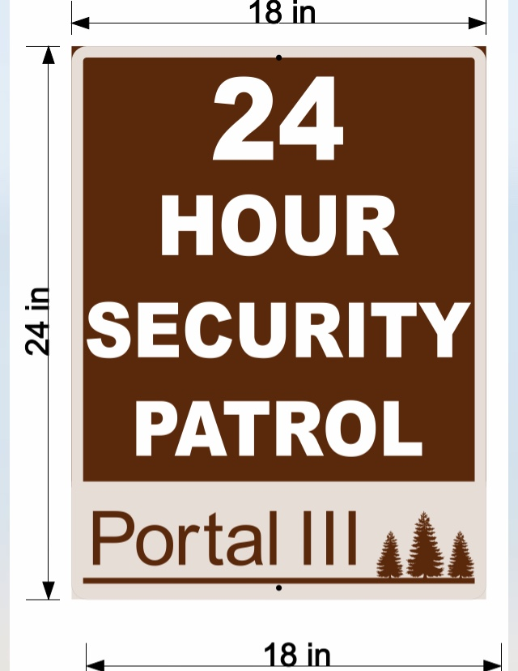
1st Sign Revised
Will be slightly revised and the format for the remainder of the signs.

Slide 7
INFORMATIONAL SIGNAGE 2nd Sign
The Committee feels strongly that we need Private Road Signs - liability, trespassing
The board did not like the sign presented last meeting, so we are presenting another option
15 Signs + Posts $1,000.

Slide 8
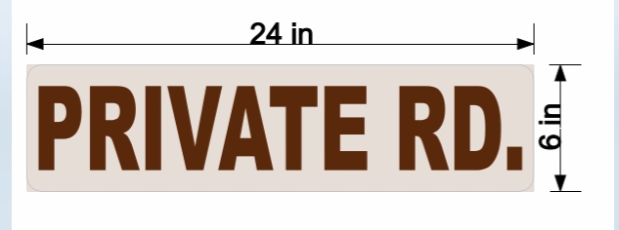
Private Road Sign - option
Private Road means NO Trespassing and limits HOA liability
Need 15 Signs for on top of street signs to decrease visual clutter
15 Signs - $525

Slide 9
INFORMATIONAL SIGN 3rd Sign
Need 1 sign at each entrance - * Focused the signage for minimal text $150

Slide 10
NO HUNTING SIGNS
Effective June 1, 2019 No Bow & Arrow Hunting Laws Change to match Gun usage laws
June 1, 2019 ALL - NO HUNTING SIGNS on individual lots can come down.
ONLY signs to be the one at Front Entrances

Slide 11
INFORMATIONAL SIGNAGE - 4th Sign
Trail Access Signs
Propose 3 signs
front side - NO Parking, NO Forest Access
back side - Private Property, NO Trespassing
Estimate price - $120.

Slide 12
GREEN HOUSE NUMBER SIGNS
PURPOSE
FIRE, POLICE, EMERGENCY VEHICLES
Visible Day & Night, Snow or no-snow, as vehicle comes up the hill

Slide 13
Sign DO’s

Slide 14
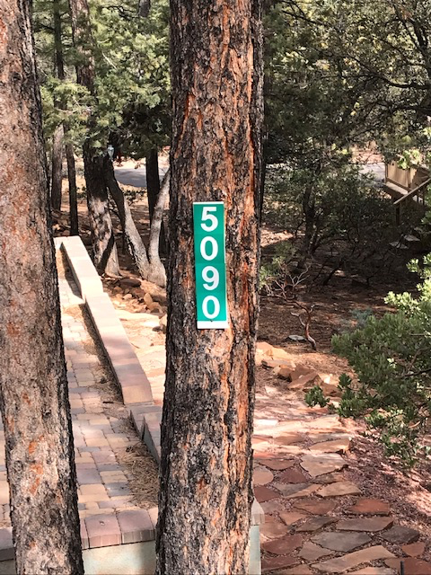

Slide 15
Sign Don’ts

Slide 16
LOT NUMBER SIGNS
The Football shaped Lot # sign
used by Water Dept
used by HOA board members
Place by Driveway of home near your house # sign if possible
OLD lot number signs - when development built - Please remove once new Lot Number Sign is up

Slide 17
OFF PROPERTY SIGN -
Pine Creek Canyon Sign
New Sign - Portals 3 1/4 mile (with arrow pointing left)
Utilize old posts - paint brown
Rectangular metal sign, to match other signage
One Sign estimate $150.

Slide 18
MONUMENT SIGN
Discuss at FALL HOA MEETING where several examples will be shown based on feedback received.

Slide 19
Wrap-Up
Request approval to purchase signs for $1200.
Private Road Signs (15) $525.
NO signs for both Entrances (2) $150.
24 Hour Security sign for 2nd entrance (1) $44.
NO Trail access signs (3) $120
Pine Creek Canyon Rd sign (1) $150.
Misc. Paint, dump fees…..
Will Use old sign posts and re-paint as necessary, labor by Chuck, Tom L., Tom H., and other volunteers.

